Slide 1
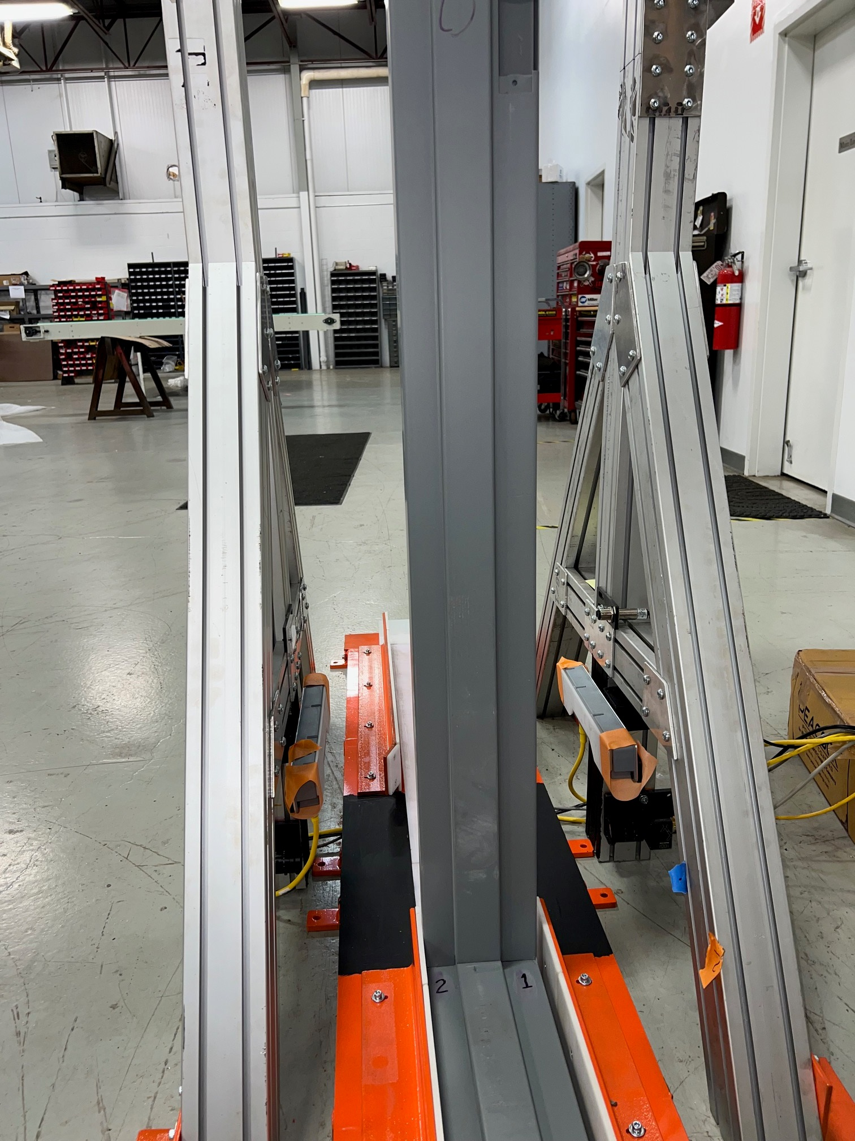
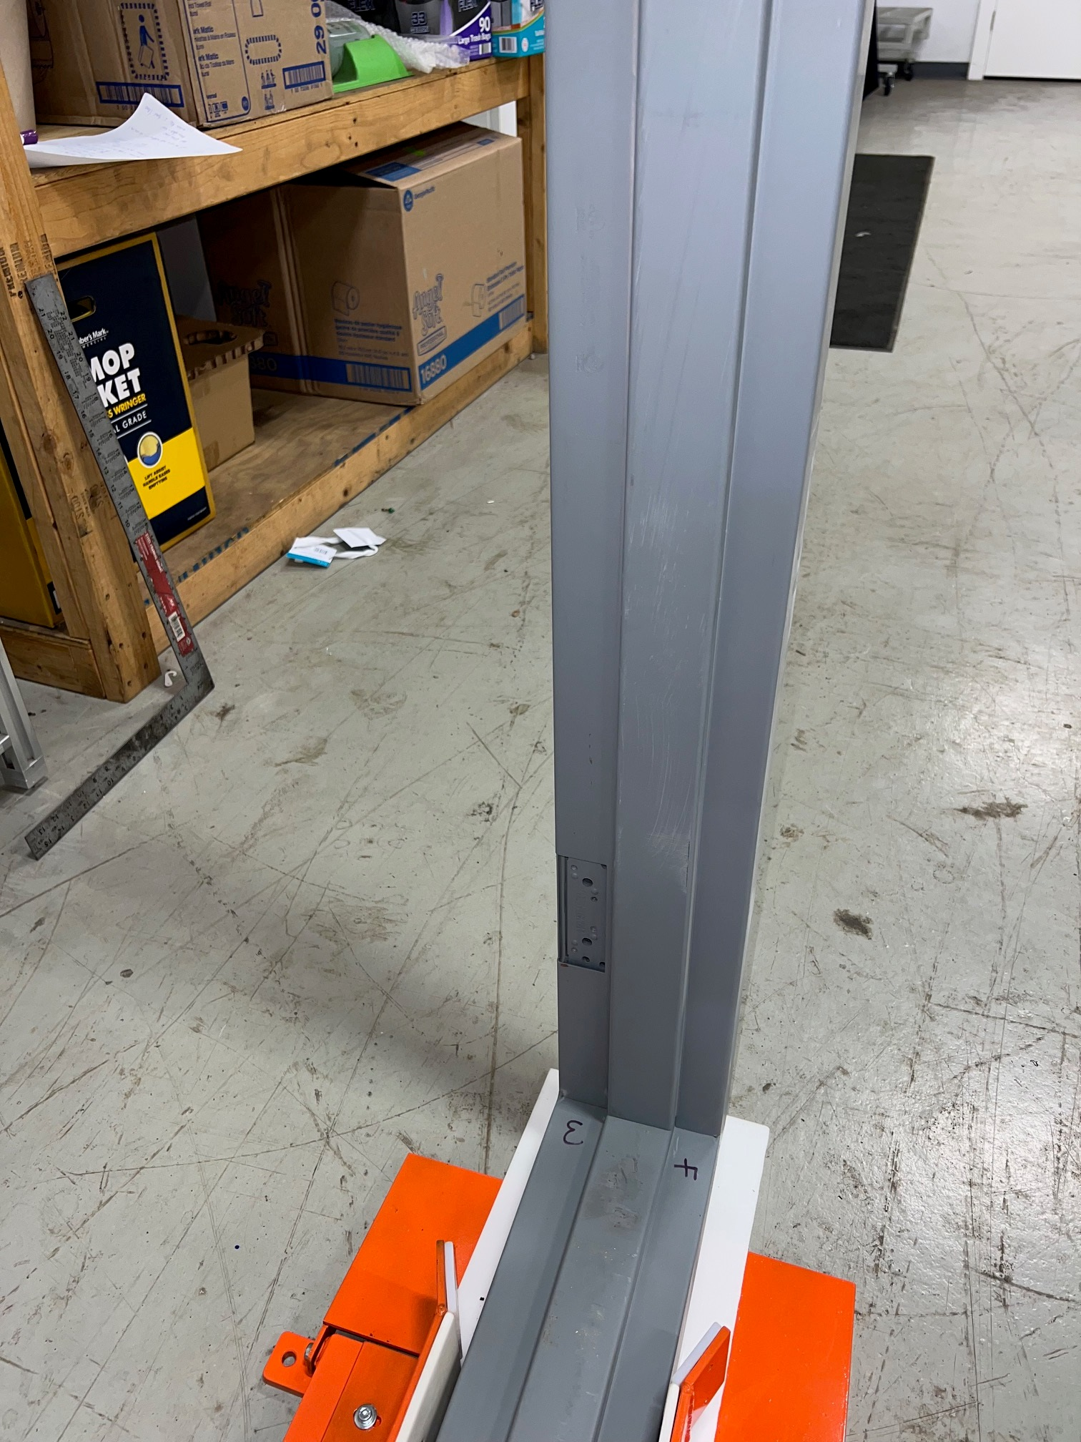
Rabbit
Strike Side
Run Frame – Direction – Strike Jamb First
Corner (1)- Strike Rabbit to Head
Corner (2)-Rabbit to head opposite Strike
Corner (3)-Hinge Rabbit to head
Corner (4)-Rabbit to head Opposite Head
Hinge Side
Head

Slide 2
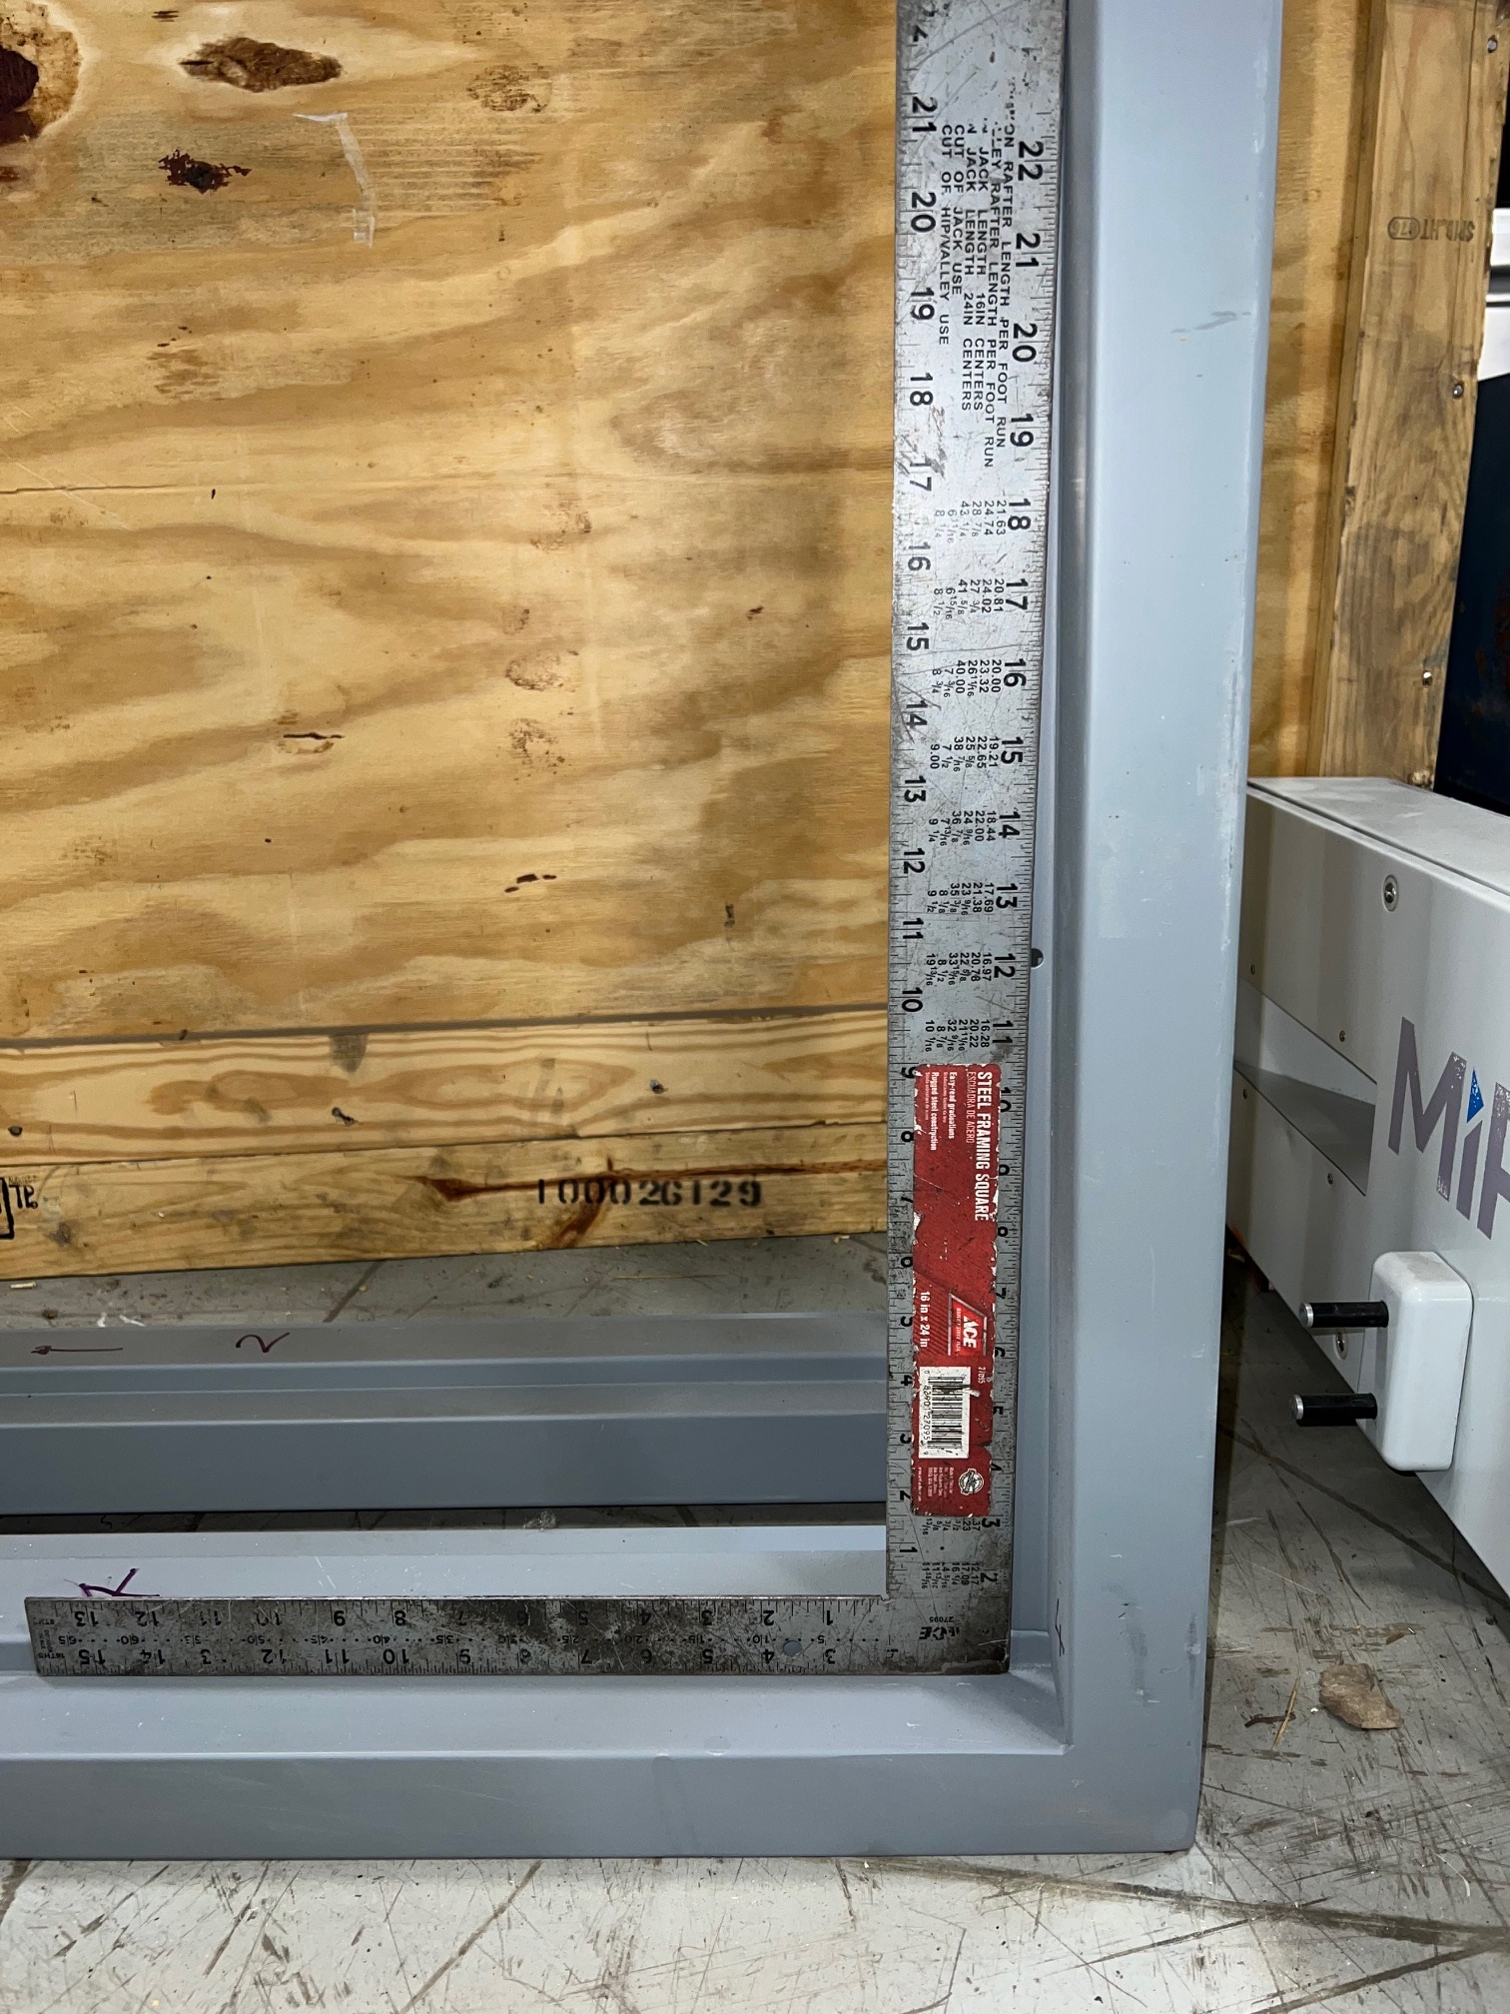
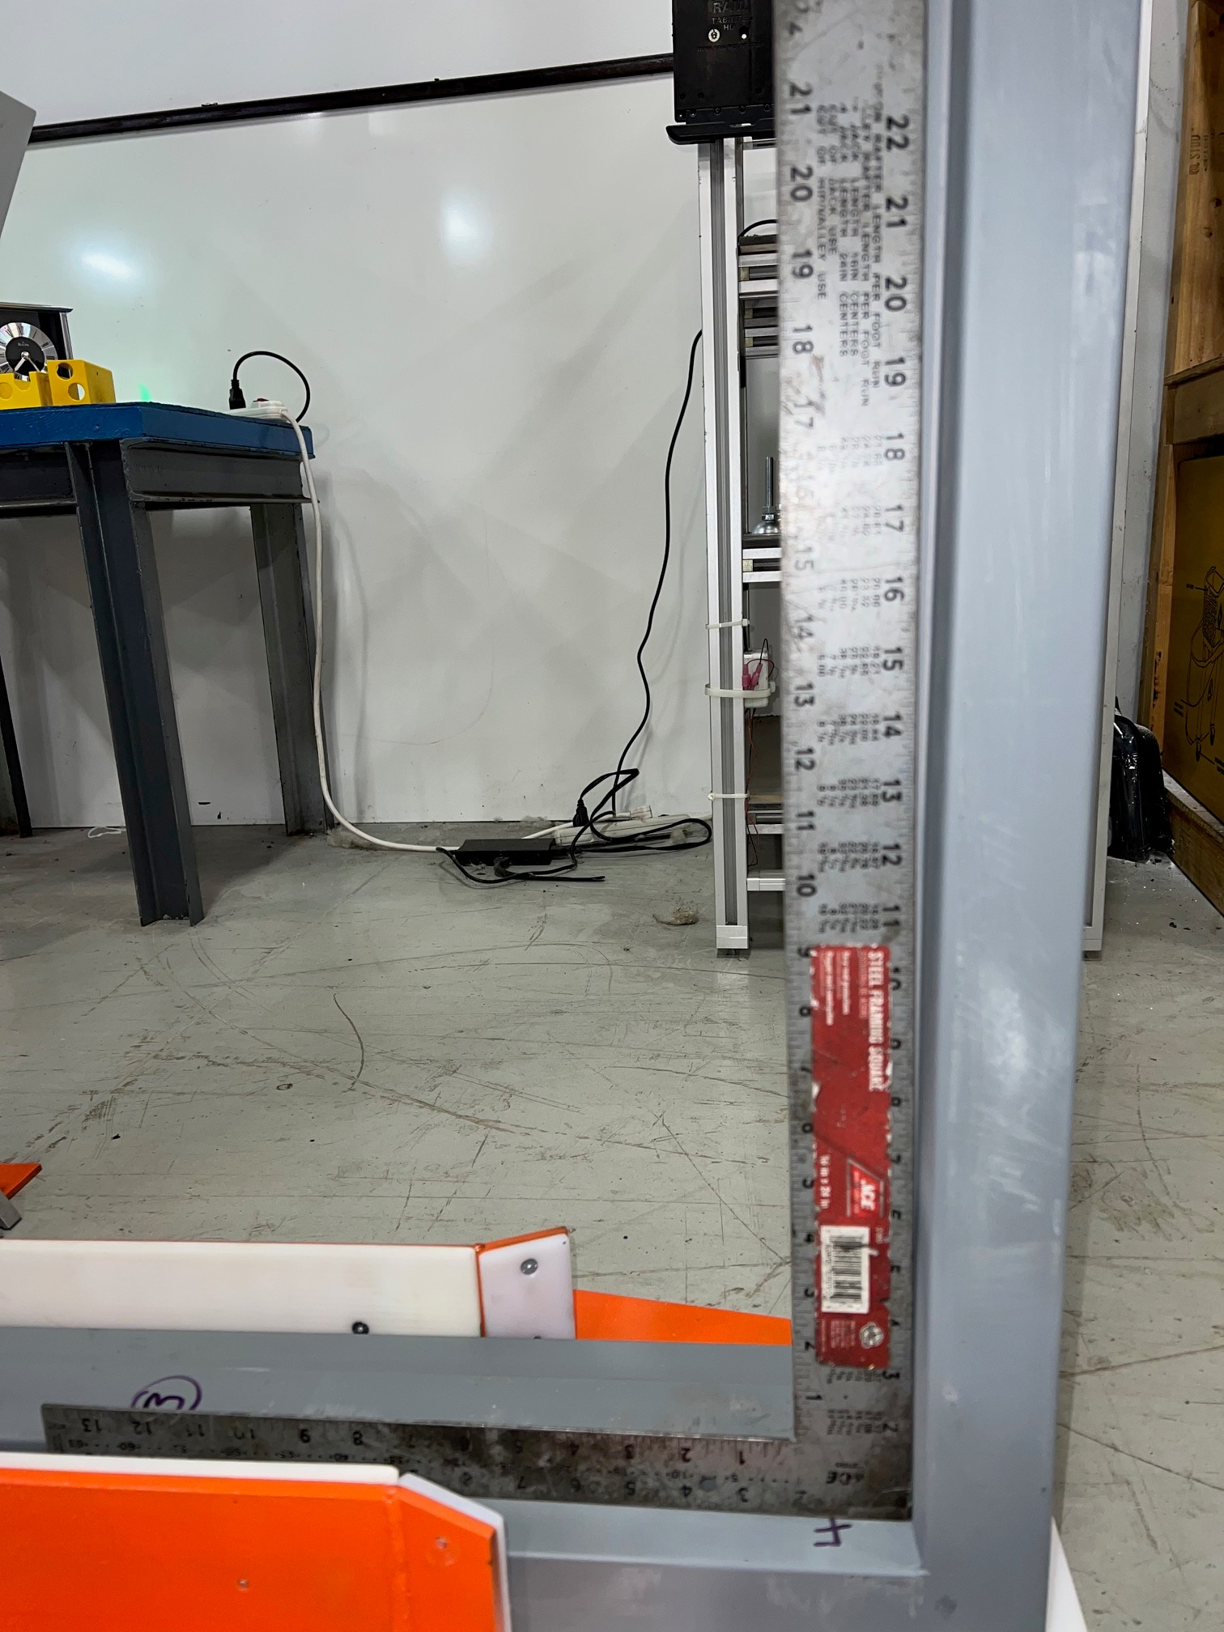
Inward
Outward
Determine Square
(1)Hinge Jamb to Head- Door side
(2)Strike side to Head-Door Side
Corner (1) and (3) are Most
Important for Square

Slide 3
We want to be able to report if defect is on the
hinge jamb or the strike jamb, and if the defect
is on the door side or the opposite side.
Doors can be left-handed or right-handed
The trilemma:
When viewed from behind camera 1, is the
doorframe pushed from left to right or from
right to left?
Is the door side (important for square) seen
by camera 1 or by camera 2?
Does the strike jamb or the hinge jamb enter
the structure first?
Only two of the three can be standardised. The
third will be ambiguous depending on the
whether the door is left-handed or right-handed.
Viewing from behind
camera 1

Slide 4
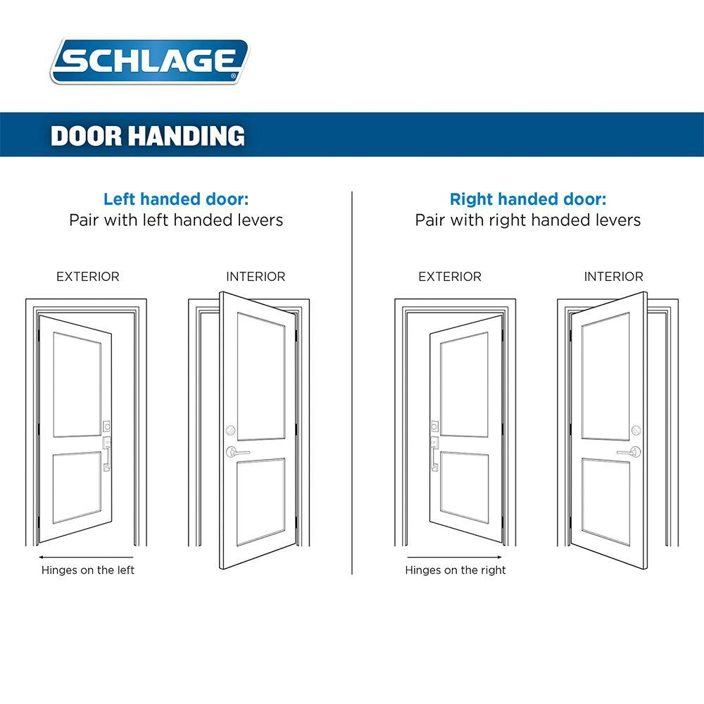
Standardise 1 (L to R) & 2 (Camera 1)
Hinge enters first
Strike enters first
Viewing from behind
camera 1
Viewing from behind
camera 1

Slide 5
Standardise 2 (Camera 1) & 3 (Strike first)
Right to left
Left to right
Viewing from behind
camera 1
Viewing from behind
camera 1

Slide 6
Standardise 3 (Strike first) & 1 (L to R)
Camera 2
Camera 1
Viewing from behind
camera 1
Viewing from behind
camera 1

Slide 7
Our Suggestion
Standardise 1 (to avoid confusion on the floor) and 2 (to determine if angle defects are critical or not)
Instead of reporting on hinge/strike jamb, we will report as jamb 1/2. Since the report is coming soon after operator has pushed the frame, it will be straightforward for them to understand where the defect is.

